Slide 1
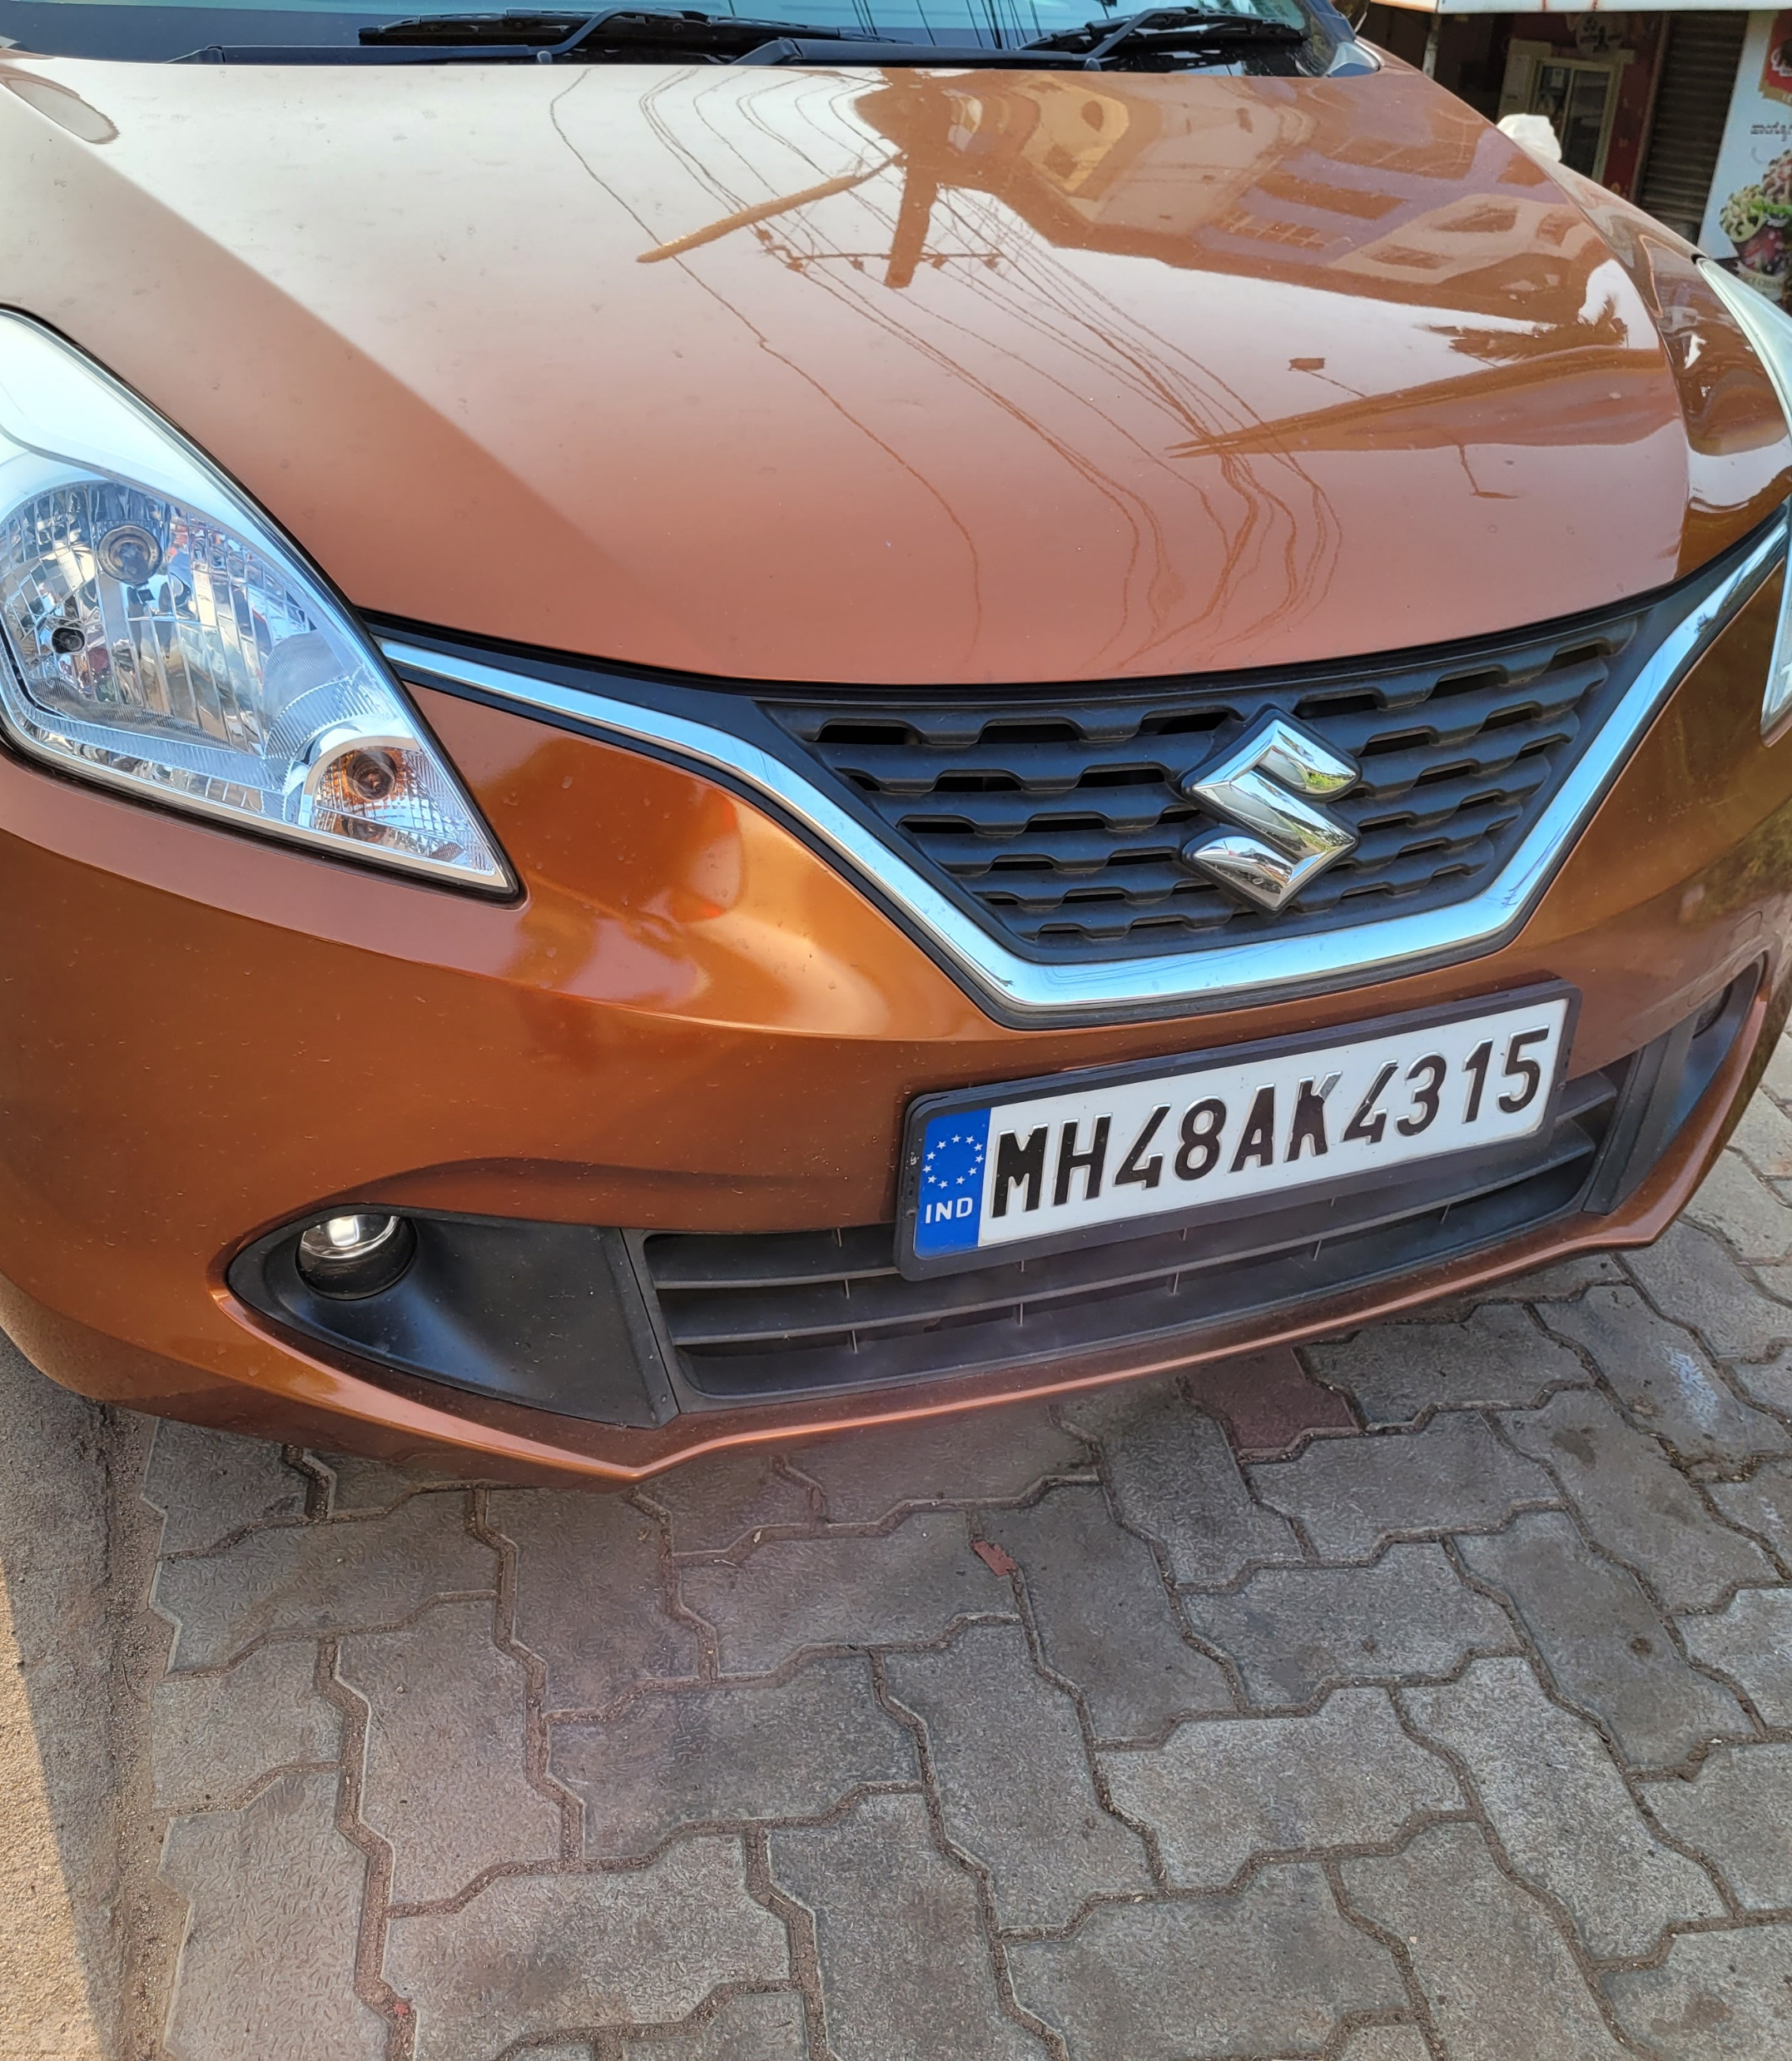


Vehicle License Plate Recognition
Nitin Medisetti
D Sai Shreyas
Bhanu Prasad AJ
Juvvi Manas Sashank

Slide 2
Outline
Introduction
Literature Review
Discussion of Base Paper
Methodology
Result
Future Scope
Reference
Team members contribution

Slide 3
Introduction
In this project, we aim to extract an automobile's vehicle number, taking its number plate as an input image and searching the database for that recognized number plate even in low light conditions.
This project has a wide range of applications since the license number is the primary, most widely accepted & mandatory identifier of vehicles. Some of the applications are:
Authentication to enter any private premises.
Identification when traffic rules are violated.
Toll booths.
Security cameras, etc..
3

Slide 4
Literature Survey
A. Kashyap, B. Suresh, A. Patil, S. Sharma and A. Jaiswal, "Automatic Number Plate Recognition," 2018 International Conference on Advances in Computing, Communication Control and Networking (ICACCCN), 2018, pp. 838-843, doi: 10.1109/ICACCCN.2018.8748287.
Abstract: Number Plate Recognition system is a security system. Image processing concept is used in Number Plate Recognition system. OCR (Optical Character Recognition) scheme is also applied in this for reading the image of vehicle number plate. Number Plate Recognition system is used for many purposes like tollway authorities uses this system for allowing the vehicle to enter the toll road by detecting their number plate automatically and provide them with pay-slip and then open the road for that particular car. Parking authorities also use this system for allowing the vehicle to park in their area. In this system, firstly we capture the image of number plate then process it and read each and every character present in the number plate for their perfect recognition. The most significant phase is OCR, where the letterings on the image of number plate are changed into the texts which can be decoded later. In this given research paper, a full algorithm and network flow for ANPR and its efficient applications are shown. The concept of ANPR system is based on the matching of templates and exactness (result) of this system was established as 75-85% for Indian number plates.

Slide 5
Base Paper Discussion
Working
Capturing the image of number plate then process it and read each and every character present in the number plate for perfect recognition.
Process
Number plate area detection Breakdown of characters Optical Character Recognition
Binary Image Processing
Gray-Level Processing
Color Processing
Adaptive Thresholding
Contrast Extension
Median Filtering
Character Segmentation
Feature Extraction
OCR by use of Template Matching

Slide 6
Challenges
Noisy images and low illumination.
Localization of the license plate from the input image.
Effect of skew on text recognition.
Wear and tear of license plates which may make them hard to be recognized

Slide 7
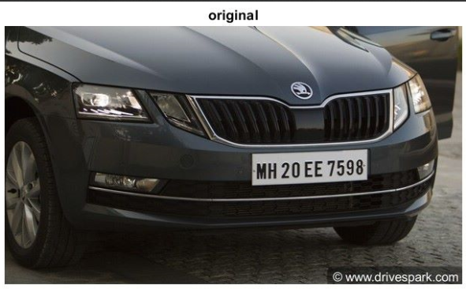
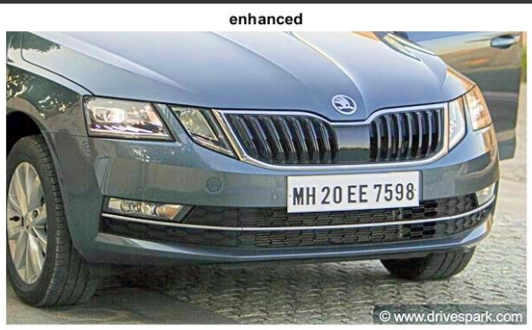
Methodology
Pre-processing
Image enhancement for low light images
Why?
Images have low dynamic ranges with high noise levels. Low-light image enhancement improves the visibility of an image.
Image Haze reduction:
The RGB image is complemented (imcomplement), then the haze present in the low light regions in the image is reduced (imreducehaze) . The resultant image after inverting it back is enhanced.

Slide 8
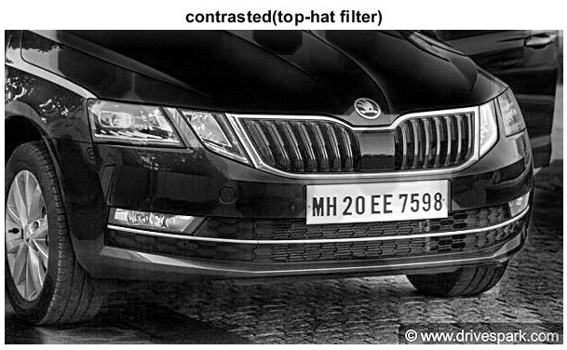
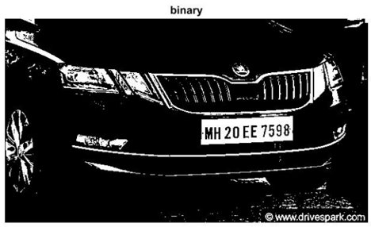
Image converted to grey scale using rgb2gray
Top Hat filtering
Top hat filtering is computing the morphological opening of the image and subtracting it from the original image. It is used to segment the images into different regions.
Why?
To remove uneven background illumination from an image with a dark background.
Binarizing the Image
Image Binarization is the conversion of document image into bi-level document image. Image pixels are separated into dual collection of pixels, i.e. black and white. The main goal of image binarization is the segmentation of document into foreground text and background.

Slide 9
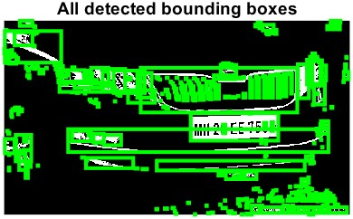
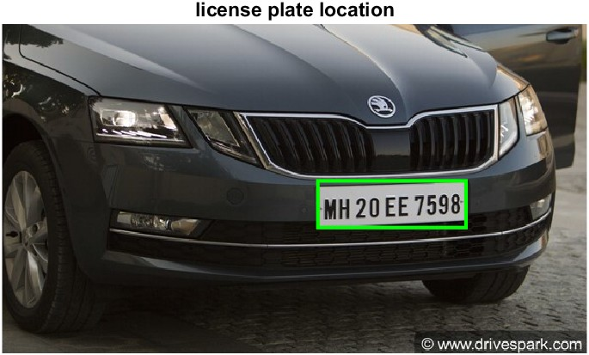
Localization ​
For segmentation 'regionprops' function has been used, it returns measurements for all 8-connected components in a binary image and groups them as rectangles(bounding boxes).
The rectangle with the largest area covered with white pixels is the license plate
This rectangle can be cropped from the image to get the localized license plate.

Slide 10
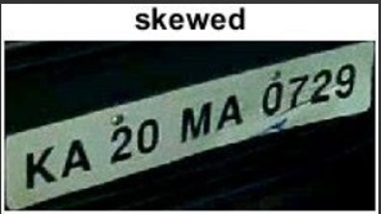
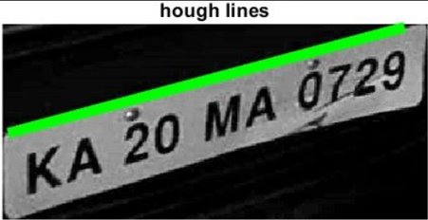
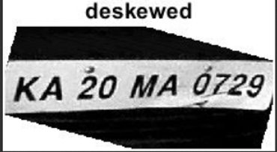
Deskewing using Hough Transform
A process whereby skew (slant) is removed by rotating an image by the same amount as its skew but in the opposite direction.
Hough Transform:
It is a feature extraction technique that converts an image from Cartesian to polar coordinates . It can be used to detect lines or a set of collinear points on the image.
Steps
Apple Canny filter on a gray scaled image.
Find Hough lines between 0.1-to-180-degree angle.
Round the angles from line peaks to 2 decimal places.
Find the angle with the highest occurrence.
Rotate the image with that angle

Slide 11
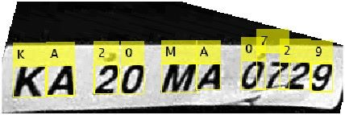
Optical Character Recognition (OCR)
Optical Character Recognition, is a process of recognizing text inside images and converting it into an electronic form. These images could be of handwritten text, printed text like documents, receipts, name cards, etc., or even a natural scene photograph.
OCR has two parts to it. The first part is text detection where the textual part within the image is determined. This localization of text within the image is important for the second part of OCR, text recognition, where the text is extracted from the image.
Searching the database for License plate details
The license plate numbers of the vehicles that are allowed to enter campus premises are stored in a .csv file. The resultant string obtained from OCR is searched for in the database, if the string is present a prompt is given to allow the vehicle inside.

Slide 12
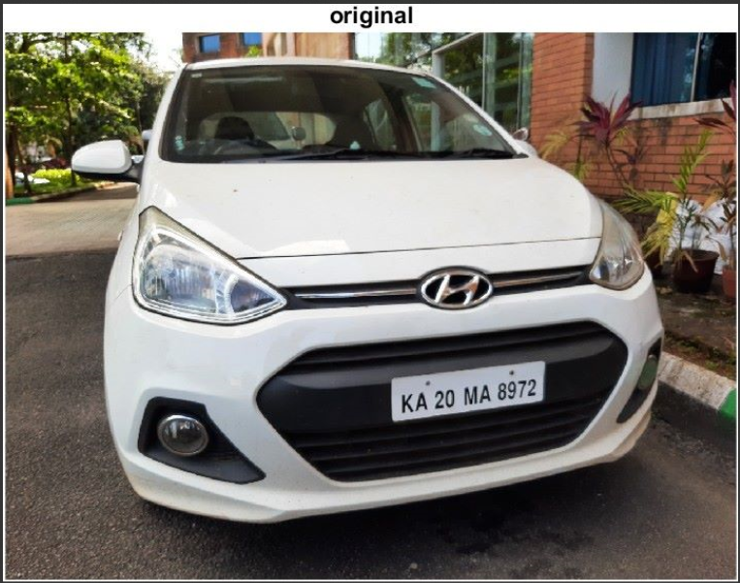
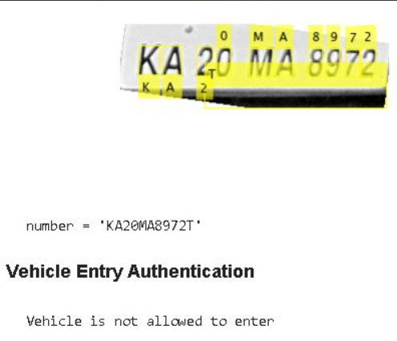
Results
Normal Image

Slide 13
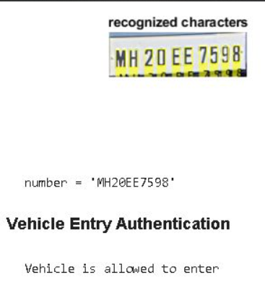
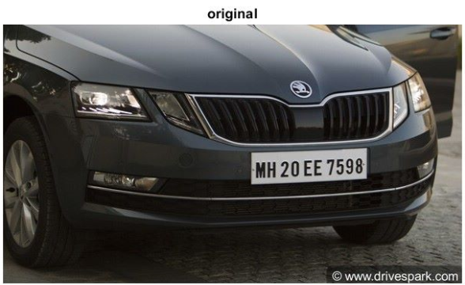

Slide 14
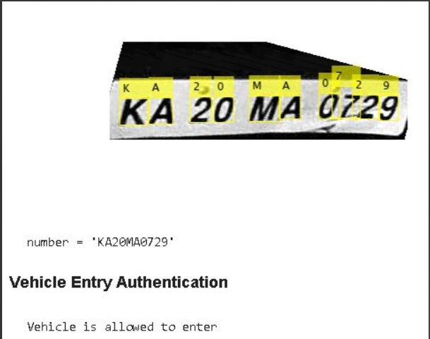
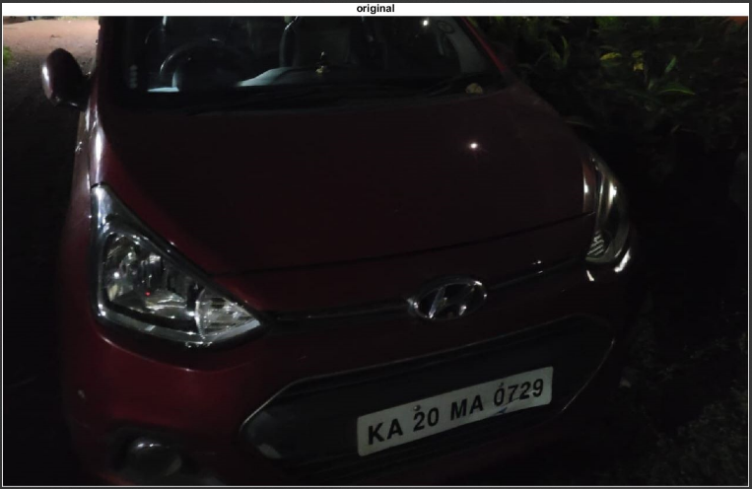
Image with low illumination

Slide 15
Future Scope
To improve the accuracy of localization and text recognition, a deep neural network model can be designed and trained on a dataset.
Retinex algorithm can be used to enhance images taken for better results in low illumination.

Slide 16
References
A. Kashyap, B. Suresh, A. Patil, S. Sharma and A. Jaiswal, "Automatic Number Plate Recognition," 2018 International Conference on Advances in Computing, Communication Control and Networking (ICACCCN), 2018, pp. 838-843, doi: 10.1109/ICACCCN.2018.8748287.
“imreducehaze,” MATLAB & Simulink Example - MathWorks India. [Online]. Available: https://in.mathworks.com/help/images/low-light-image-enhancement.html. [Accessed: 04-Nov-2022].
K. Amplifier, “Text skew detection & correction using Hough transform | digital image processing | MATLAB,” 22-Jul-2020. [Online]. Available: https://www.youtube.com/watch?v=83nAgfAiv7U. [Accessed: 03-Nov-2022].

Slide 17
Team Contribution
S.no. | Name | Registration No. | Responsibility/ Contribution
1 | Nitin Medisetti * | 190929100 | Implementation/Research
2 | Juvvi Manas Sashank | 190929242 | Implementation/Documentation
3 | D Sai Shreyas | 190929238 | Research/Documentation
4 | Bhanu Prasad A J | 190929068 | Implementation/Documentation

Slide 18
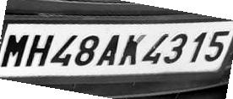
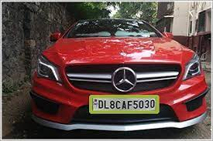
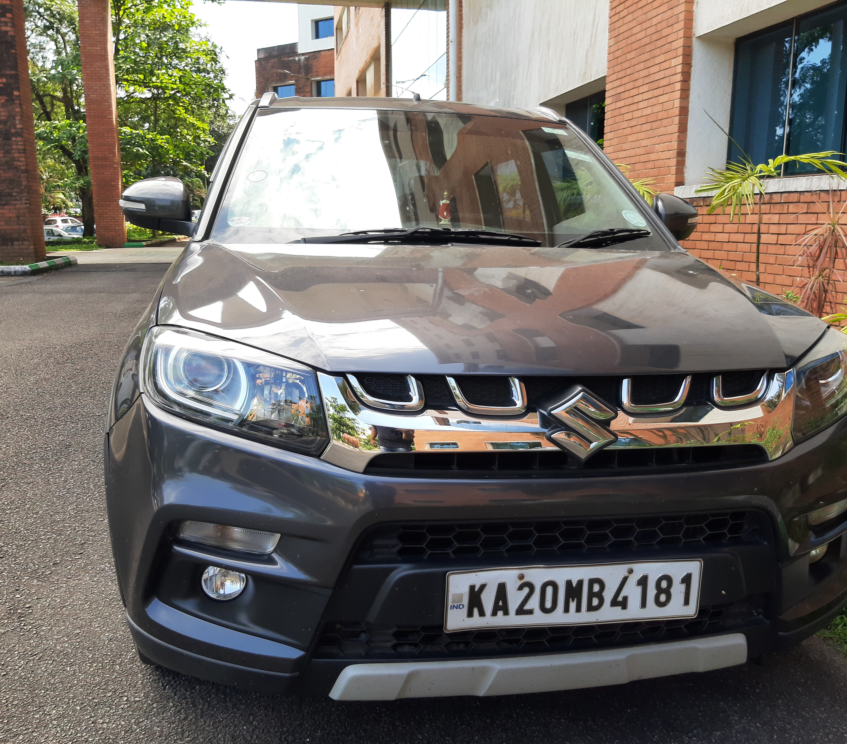
Implementation

